Slide 1
IIME
By Group 3

Slide 2
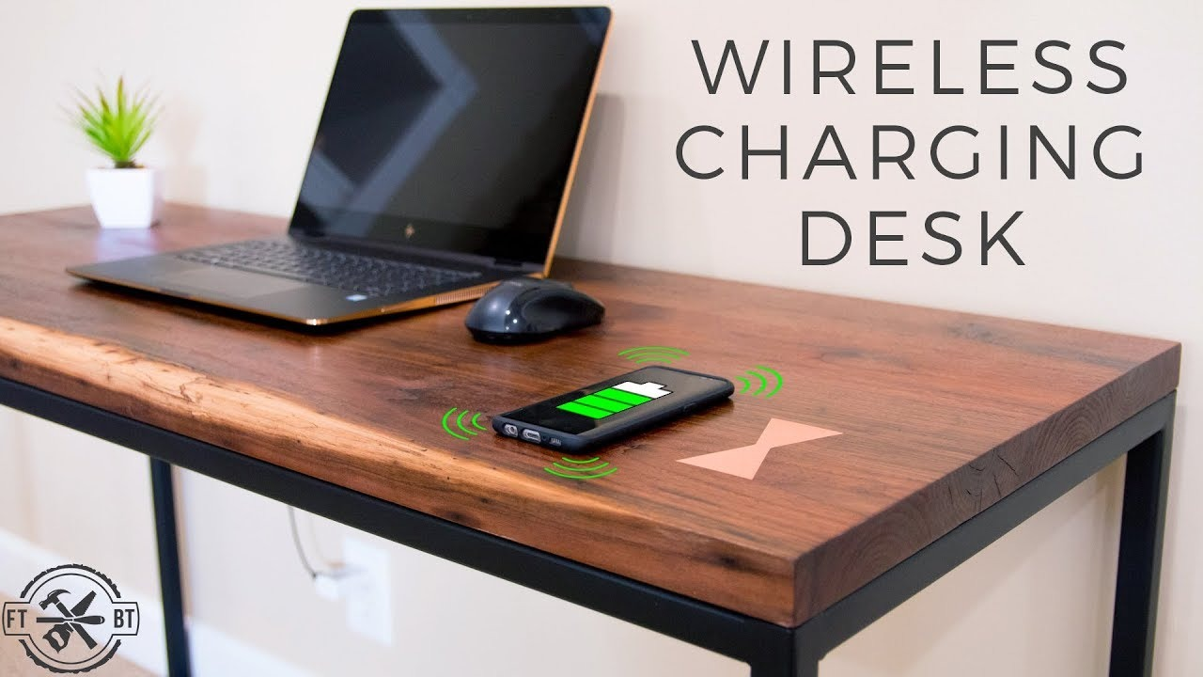

Slide 3
1. Is the idea for a new venture clear?
Yes , It is crystal clear.
2. Is it Technology Push or Market Pull?
Technology Push
3. Why is it interesting ? Who are the Potential customer and how is it better?
It is interesting because your devices are getting charged just by keeping on the desk.
It is more promising thank exiting technology because if you have many devices plugged in to the same port then the wires get tangled. Beneficial when you don’t have any sockets nearby.
Multiple devices can be charged at the same time.
It can also be converted to a standing desk.
Also, it is environment friendly. Potential customers are the companies that are completely dependent on use of computers, so this desk can be replaced in place of them.

Slide 4
4. What hypothesis need to be true for this venture ?
Yes
5. When would you walk away from this effort ?
1)You have been operating with next to no profit.
2)Despite marketing and research showing your product is desirable, you have continued low interest from customers.
3)Your idea or product is too common and larger companies have it covered.
4)Losses are getting greater.
6. Describe a scenario where this would be very exciting to you ?
Technology Push

Slide 5
7. What type of team do you need ?
Hardworking
Flexible
Forward looking
Clear communication
Shared vision
Skills

